Slide 1



SustainDrive
Case Study:
SustainDrive – Vehicle Carbon Emission Prediction
Student names:
Samarth Shendre
Raj Solat
Om Rathod
Om Rokde

Slide 2
Problem Statement
Brief Overview :
Carbon emissions from vehicles, particularly older models, contribute significantly to environmental pollution and climate change. Image-based vehicle inspection enables the detection of carbon emissions and damage by analyzing visual cues from exhaust smoke, engine components, and body conditions. Advanced AI models process these images to identify emission levels and assess maintenance needs, helping to reduce environmental pollution and optimize vehicle performance.
Real-Life Example : Volkswagen was found to have manipulated emission tests, where their diesel cars emitted far more NOx (Nitrogen Oxides) pollutants than legally allowed.
This led to higher carbon emissions and environmental damage, affecting air quality and public health.
This scandal highlighted the need for better emission monitoring technologies, making AI-driven vehicle scanning a critical innovation in sustainability.
SustainDrive – Sinhgad College of Engineering

Slide 3
Key Objectives :
1️⃣ Carbon Emission Detection**
Uses image analysis to detect excessive smoke, CO₂, and NOx emissions from vehicle exhaust.
2️⃣ Real-Time Vehicle Health Monitoring**
Scans for damages, rust, leaks, and worn-out tires that impact fuel efficiency and emissions.
3️⃣ Eco-Friendly Driving Insights**
Provides carbon footprint scores and AI-driven recommendations for reducing emissions.
4️⃣ Regulatory Compliance & Pollution Monitoring**
Checks emission compliance with pollution norms and helps authorities track high-emission vehicles.
5️⃣ Integration with Smart Mobility & Sustainability Initiatives**
Suggests EV transitions, carpooling, and smart city solutions to minimize carbon impact. 🚗🌍
SustainDrive – Sinhgad College of Engineering

Slide 4
Dataset Overview :
1️⃣ Vehicle Exhaust Emission Dataset**
Contains images of vehicle exhaust with labeled emission levels (low, moderate, high) and smoke color analysis.
2️⃣ Thermal & Infrared Imaging Dataset**
Includes thermal images of vehicle exhaust to detect excessive heat emissions and fuel inefficiency.
3️⃣ Vehicle Damage Detection Dataset**
Features images of dents, scratches, tire wear, and rust for AI-based vehicle health assessment.
SustainDrive – Sinhgad College of Engineering

Slide 5
Methodology
1️⃣ Image Acquisition
Capture vehicle exhaust images using smartphone cameras, dashcams, or CCTV.
Use thermal and infrared imaging for accurate heat and gas emission analysis.
2️⃣ Preprocessing & Feature Extraction
Enhance image quality using noise reduction and edge detection techniques.
Extract key features like smoke color, density, and opacity levels.
3️⃣ AI-Based Image Analysis
Use Computer Vision (CNNs, YOLO, OpenCV) to classify emission levels.
Apply Deep Learning models to detect patterns in exhaust emissions.
4️⃣ Emission Classification & Carbon Footprint Estimation
Compare detected emissions with regulatory standards (BS6, Euro 6, EPA).
Estimate carbon footprint based on detected pollution levels.
5️⃣ Vehicle Health & Damage Detection
Scan vehicle body for scratches, dents, rust, tire wear, and leaks.
Use AI models for predictive maintenance suggestions.
SustainDrive – Sinhgad College of Engineering

Slide 6
Algorithms Used:
1️⃣ OpenCV – Used for image preprocessing, feature extraction, and smoke density detection.
2️⃣ CNN (Convolutional Neural Networks) – Helps in classifying emissions and detecting vehicle damage from images.
3️⃣ Random Forest – Used for categorizing emission levels based on extracted image features.
SustainDrive – Sinhgad College of Engineering

Slide 7
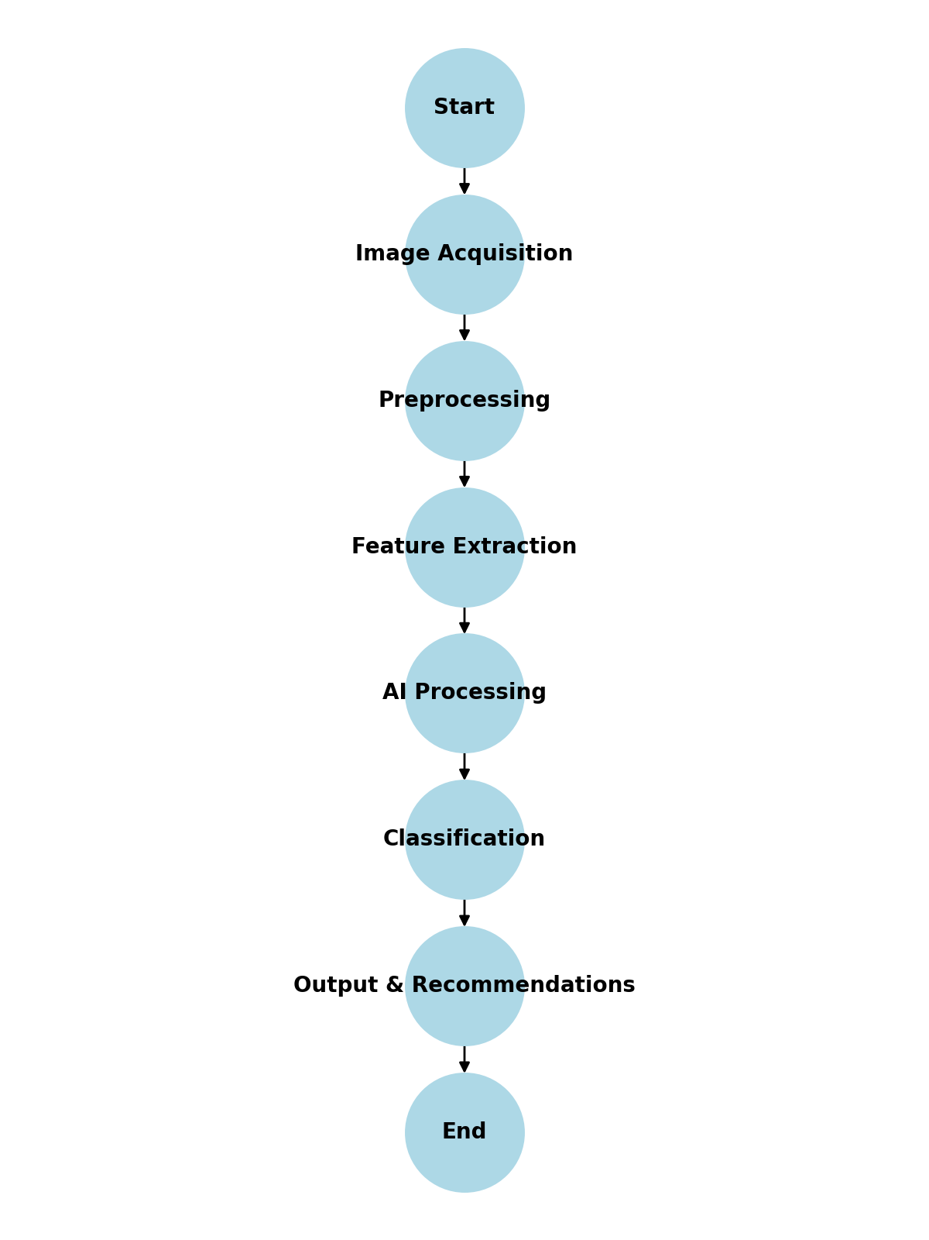
Flow Chart:
Fig : SustainDrive - Vehicle Maintenance
SustainDrive – Sinhgad College of Engineering

Slide 8

Conclusion
The SustainDrive Application effectively utilizes image-based carbon emission and vehicle damage detection to promote sustainable transportation. By leveraging OpenCV for preprocessing, CNN for deep learning-based classification, and Random Forest for emission level categorization, the system ensures accurate analysis and real-time insights. This approach enhances vehicle maintenance, reduces carbon footprints, and contributes to a cleaner environment by providing actionable recommendations. SustainDrive serves as a smart, AI-driven solution for optimizing vehicular health and environmental sustainability.
SustainDrive – Sinhgad College of Engineering

Slide 9
References
1️⃣ OpenCV Documentation – OpenCV library for image processing and feature extraction. (https://docs.opencv.org/)
2️⃣ CNN for Image Classification – Deep learning techniques for emission and damage detection. (https://www.tensorflow.org/tutorials/images/classification)
3️⃣ Random Forest Algorithm – Machine learning approach for emission level classification. (https://scikit-learn.org/stable/modules/generated/sklearn.ensemble.RandomForestClassifier.html)
4️⃣ Vehicle Emission Analysis Studies – Research papers on carbon emission detection using AI. (IEEE Xplore, ResearchGate, Springer)
5️⃣ Automobile Damage Detection Systems – AI-based solutions for vehicle inspection. (Journal of Intelligent Transportation Systems, Elsevier)
SustainDrive – Sinhgad College of Engineering

Slide 10
Thank You
Notes:
Thank You !!

